Slide 1



NETFLIX STOCK ANALYSIS
Presenter- SAKSHI

Slide 2

INTRODUCTION
Stock Market Analysis means analyzing the current and historical trends in the stock market to make future buying and selling decisions. To analyze the stock market , I collect the stock price data of Netflix.

Slide 3


OBJECTIVES
Volume of Stock Traded
Netflix stock analysis- High, Open,Close
Netflix stock analysis - Day, Month and year wise
Top- 5 Dates with highest stock price
Top-5 Dates with lowest stock price

Slide 4
Importing the necessary Python libraries
import numpy as np
import pandas as pd
import matplotlib.pyplot as plt
import seaborn as sns
from datetime import datetime

Slide 5
df= pd.read_csv('D:\\Netflix.csv')
print(df.head())
Date Open High Low Close Adj Close Volume
0 2002-05-23 1.156429 1.242857 1.145714 1.196429 1.196429 104790000
1 2002-05-24 1.214286 1.225000 1.197143 1.210000 1.210000 11104800
2 2002-05-28 1.213571 1.232143 1.157143 1.157143 1.157143 6609400
3 2002-05-29 1.164286 1.164286 1.085714 1.103571 1.103571 6757800
4 2002-05-30 1.107857 1.107857 1.071429 1.071429 1.071429 10154200

Slide 6
Explanation of Columns:
1. Date: The date of each trading day.
2. Open: Day's starting price
3. High: Intraday peak price
4. Low: Lowest intraday price
5. Close: End-of-day price
6. Adj Close: The adjusted closing price, accounting for corporate actions such as dividends and stock splits
7. Volume: The total number of shares traded on that day.
These columns provide detailed information about Netflix stock prices and trading activity.

Slide 7
print(df.tail())
Date Open High ... Close Adj Close Volume
4869 2021-09-24 592.500000 592.979980 ... 592.390015 592.390015 2124800
4870 2021-09-27 587.950012 593.580017 ... 592.640015 592.640015 2504700
4871 2021-09-28 589.000000 599.539978 ... 583.849976 583.849976 4431100
4872 2021-09-29 589.010010 609.880005 ... 599.059998 599.059998 6221000
4873 2021-09-30 608.049988 619.000000 ... 610.340027 610.340027 6612600
[5 rows x 7 columns]

Slide 8
df['Date']=pd.to_datetime(df['Date'])
df=df.set_index('Date')
print(df.head())
Open High Low Close Adj Close Volume
Date
2002-05-23 1.156429 1.242857 1.145714 1.196429 1.196429 104790000
2002-05-24 1.214286 1.225000 1.197143 1.210000 1.210000 11104800
2002-05-28 1.213571 1.232143 1.157143 1.157143 1.157143 6609400
2002-05-29 1.164286 1.164286 1.085714 1.103571 1.103571 6757800
2002-05-30 1.107857 1.107857 1.071429 1.071429 1.071429 10154200

Slide 9
sns.set(rc={'figure.figsize' :(10,5)})
sns.lineplot(x=df.index, y=df['Volume'],label='Volume')
plt.title("Netflix Stock Volume Over Time")
plt.show()

Slide 10
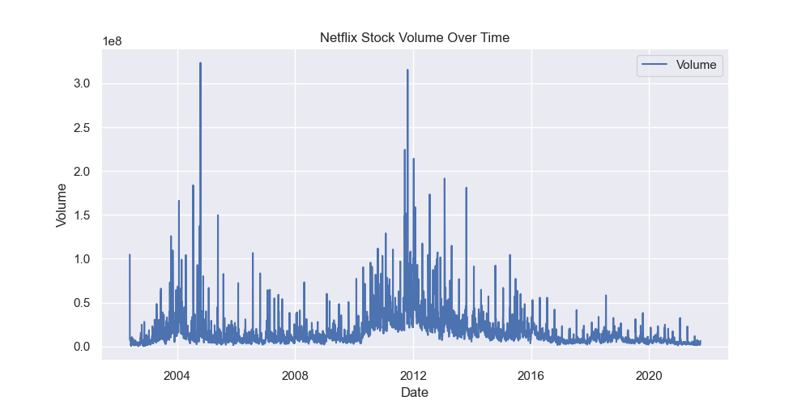

Slide 11
Observation
- Netflix stock trading volume has shown a declining trend
- Trading volume saw occasional spikes, potentially influenced by major news like Netflix releases or partnerships.
- Trading volume has been relatively low in recent months. This suggests that there is less investor interest in Netflix stock at the moment.

Slide 12
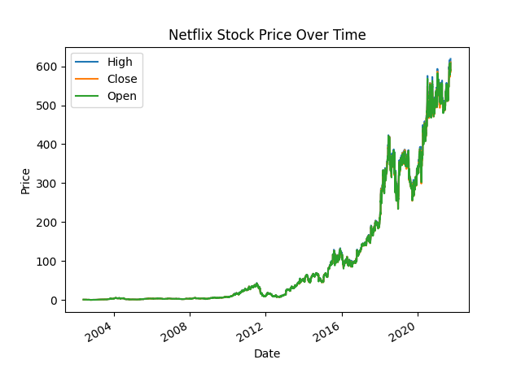
df.plot(y=['High','Close','Open'],title='Netflix Stock Price Over Time',ylabel='Price')
plt.show()

Slide 13
Observation:
- The overall trend of the Netflix stock price is generally sloping upwards.
- Periods of volatility with sharp increases and decreases in the stock price.

Slide 14
fig,(ax1,ax2,ax3) = plt.subplots(3, figsize=(5,15))
df.groupby(df.index.day).mean().plot(y ='Volume' ,ax=ax1, xlabel='Day')
df.groupby(df.index.month).mean().plot(y ='Volume', ax=ax2, xlabel='Month')
df.groupby(df.index.year).mean().plot(y ='Volume', ax=ax3, xlabel='Year')
plt.show()

Slide 15
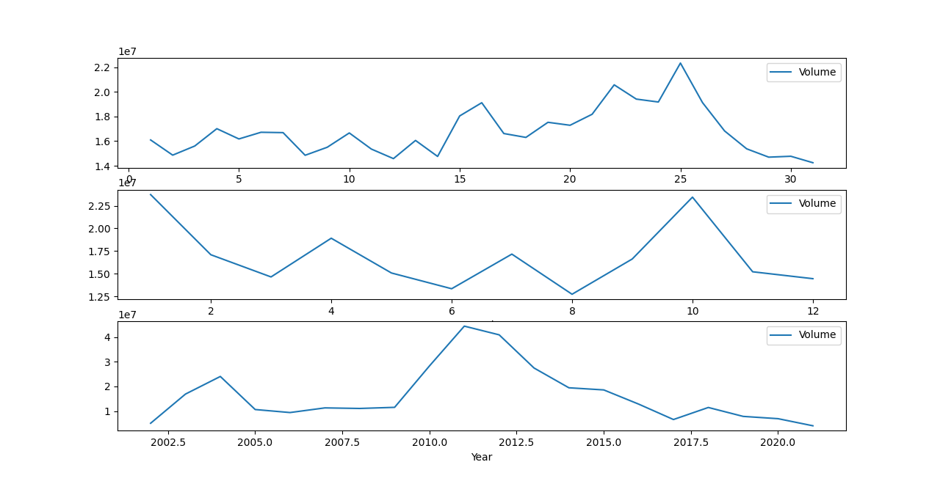

Slide 16
a = df.sort_values(by = 'High',ascending = False).head(5)
print(a['High'])
Date
2021-09-30 619.000000
2021-09-08 615.599976
2021-09-07 613.849976
2021-09-29 609.880005
2021-09-10 609.450012
Name: High, dtype: float64

Slide 17
b = df.sort_values(by = 'Low',ascending = True).head(5)
print(b['Low'])
Date
2002-10-10 0.346429
2002-10-09 0.347143
2002-10-07 0.382143
2002-10-08 0.390714
2002-10-16 0.442857
Name: Low, dtype: float64

Slide 18
fig,axes = plt.subplots(nrows=1,ncols=2, sharex=True, figsize =(12,5))
fig.suptitle('High & Low values stock per period of time',fontsize=18)
sns.lineplot(ax=axes[0], y=df['High'], x=df.index, color='green')
sns.lineplot(ax=axes[1],y=df['Low'], x=df.index, color='red')
plt.show()

Slide 19
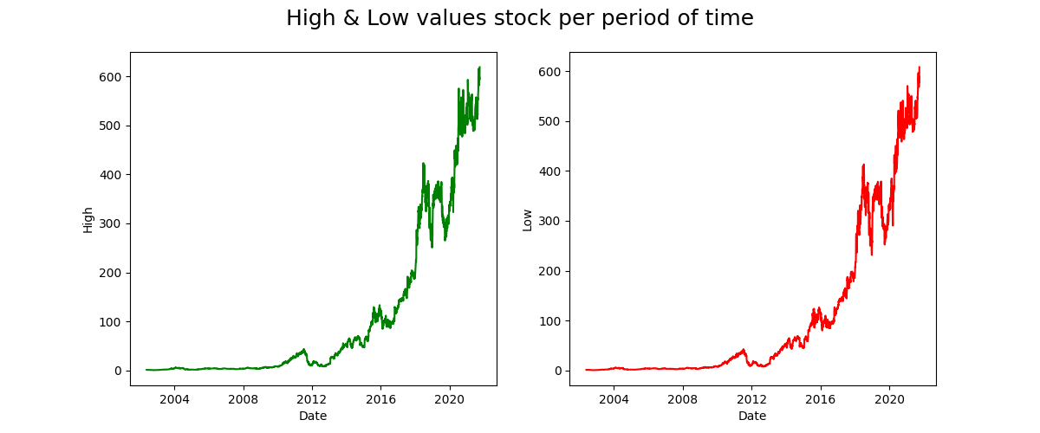

Slide 20

Thank You

